Slide 1
On the power of WL[k]
Martin Fürer
Pennsylvania State University

Slide 2
My early involvement with graph isomorphism testing
Ernst Specker tells me about Babai’s graph isomorphism test for bounded color multiplicity (1979 tech report).
The journal paper of Luks 1982 lists canonical labeling for bounded degree as an open problem.
We solve canonical labeling (F., Specker, and Schnyder, simultaneously with Babai and Luks) 1983.
Sometime before that, I learn about vertex and edge classification and I view them as special cases of a more general case of refinement by classification of k-tuples, what is now known as WL[k].
I learn that Neil Immerman invented WL[k] about the same time. Later I learn that Laci Babai invented WL[k] earlier.
I take great inspiration from the Springer Lecture notes of Weisfeiler and Leman (deep stabilization).

Slide 3
3-dim WL Refinement (WL[3])
WL[3] is more effective than just edge classification.
Algorithm:
Start: Color the ordered triples of vertices by the isomorphism type of the induced subgraph.
Loop: Color the triples (u, v, w) by the multiset of triples of colors on the sides of tetrahedrons (u, v, w, x) for all x.
Stop: When the color partition of the (ordered) triples stabilizes

Slide 4
WL[3]
x
. . .
u
w
v

Slide 5
Conjecture early 1980’s
My conjecture: WL[k] (or WL[k’] for k’=O(k)) is sufficient for degree k graphs.
Immerman had a similar conjecture.
1983: Babai and Luks strongly disagree with my conjecture.
While trying to prove the conjecture, I was lead in a systematic way towards our counterexample. I cannot recall how.
The conjecture fails drastically.

Slide 6
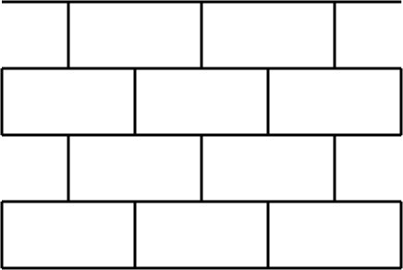
Counter-example: Both graphs
Torus of meta-vertices and meta-edges

Slide 7
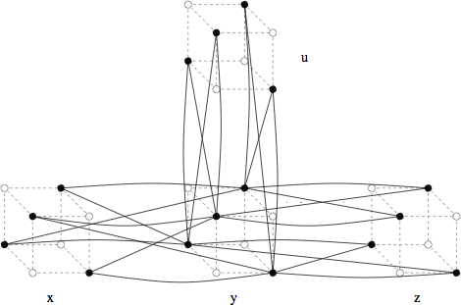
The Counter-example

Slide 8
The two non-isomorphic graphs
Both graphs use the same meta-graph.
In both, replace meta-vertices by half hypercubes.
In both, replace meta-edges by identical gadgets connecting their half hypercubes.
X₁ has straight connections,
X₂ has 1 connection flipped (or equivalently, an odd number of connections flipped).
The flip can be moved anywhere in the meta-graph.

Slide 9
The Counter-example shows:
To identify all trivalent graphs of size n by WL[k], it is required that k=Ω(√n).
Construction rejected by STOC and FOCS 1988.
The same result is submitted to FOCS 1989 by Jin-Yi Cai and Neil Immerman with detailed proofs including characterizations by Logic with Counting and by Ehrenfeucht-Fraïssé type games.
Laci Babai as PC chair suggests for my inclusion in the CFI paper.
3-regular expander graph instead of brick wall increases the lower bound to k=Ω(n).

Slide 10
Connection to Logic
L_{k}: First order logic with k variables
Example: ∀x ∃y (E(x,y) ∧ ∃x (¬E(x,y)))
C_{k:} First order logic with counting with k variables
Example: ∃ 17 x … there are 17 x …
Two graphs X, X’ cannot be distinguished by k-dim WL iff
the same C_{k+1} sentences hold for X and X’.

Slide 11
Time complexity of WL[k]
Polynomial time for k constant.
Parallel complexity?
Each round of refinement is fast (one can handle all k-tuples in parallel).

Slide 12
Example with Time Depending on k
Path of length n
k=1: After s steps, vertices with a distance
≤s from an endpoint know their distance.
Stop after Ω(n) steps.
k=2: After s steps, vertices with a distance ≤2^{s-1} from an endpoint know their distance.
Stop after O(log n) steps.
Is 2-dim WL always fast?

Slide 13
WL[2] is algebraically interesting
2
1
3
Fancy “Matrix Product”:
Square matrices using the usual matrix product
Replace different expressions by different variables.
Notes:
Luitpold Babel 1994

Slide 14
k=2 algebraically cont.
The n²-th power of M is stable.
Divide-and-conquer O(log n) time! ???
No!! This multiplication is not associative.
F. 2001: For all k, WL[k] can take Ω(n) steps.

Slide 15
Spectral graph theory
With a graph associate the vector space of all real labelings 𝓁: V→ ℝ of the vertices.
The adjacency matrix defines a linear mapping in this vector space.
The spectrum of a graph is the spectrum of its adjacency matrix.
Theorem (F. 2010)
F. 2010: If the graphs X and X’ have the same edge colors, then they have the same spectrum.

Slide 16
Graph isomorphism using linear algebra
For graphs of bounded eigenvalue multiplicities, the eigenspaces and the projections of the base vectors into the eigenspaces are computed with sufficient numerical accuracy to determine whether projections of vertices are equal and whether projections of edges are of equal length.
This allows conclusions on the block structure of the automorphism group.
Success for the combinatorial approach: The numerical computations of Babai, Grigoriev and Mount [1982] can be replaced by WL[2] (edge classification) [F. 1995]

Slide 17
Connections between Coloring and Spectral Properties
The standard basis vector of a vertex v is the labeling 𝓁 with 𝓁(v)=1 and 𝓁(u)=0 for all other vertices u.
Let p^{k}(v) be the projection of the standard basis vector of v into the k-th eigenspace.
Theorem (F. 1995)
The vertex color of v after WL[2] (edge coloring) determines the length of the projection p^{k}(v).
The edge color of {u,v} determines the angle between the projection p^{k}(u) and the projection p^{k}(v) of u and v into any eigenspace E^{k}.

Slide 18
Tool: The averaging matrix M
Let C(u) be the set of vertices with the same color as u.
m_{uv} = 1/|C(u)| if C(u) = C(v)
(0 otherwise).
Properties
  AM = MA iff the coloring is stable.
  If Ax = λx, then A Mx = λ Mx, i.e., with x, also Mx is an eigenvector to the same basis.

Slide 19
Trees
Trees are not determined by the spectrum and the lengths of the projections (form the standard basis vectors to the eigenspaces) [Stevanovic, Brankov 2006].
Conjecture: The lengths of the projections and the angles between the projections determine all trees.

Slide 20
Combinatorial invariants
F. 2017: WL[2] determines:
the number of 6-cycles, but not the number of 8-cycles (7-cycles is open).
the number of triangles (trivial), but not the number of 4-cliques. (There are 2 strongly regular graphs srg(16,6,2,2), the (4,4)-rook graph and the Shrinkhnde graph, with different numbers of K₄.)

Slide 21
Thank you!

